Slide 1


Factors That Drive Home Prices Data Insights for Mortgage-Backed Securities
Generic Investment Bank INC.

Slide 2
Why should you care?
Without looking at statistically driven data we are flying blind.
Over a million new mortgages written each year.
Being informed on what factors correlate most to housing prices will help us classify our securities better.

Slide 3
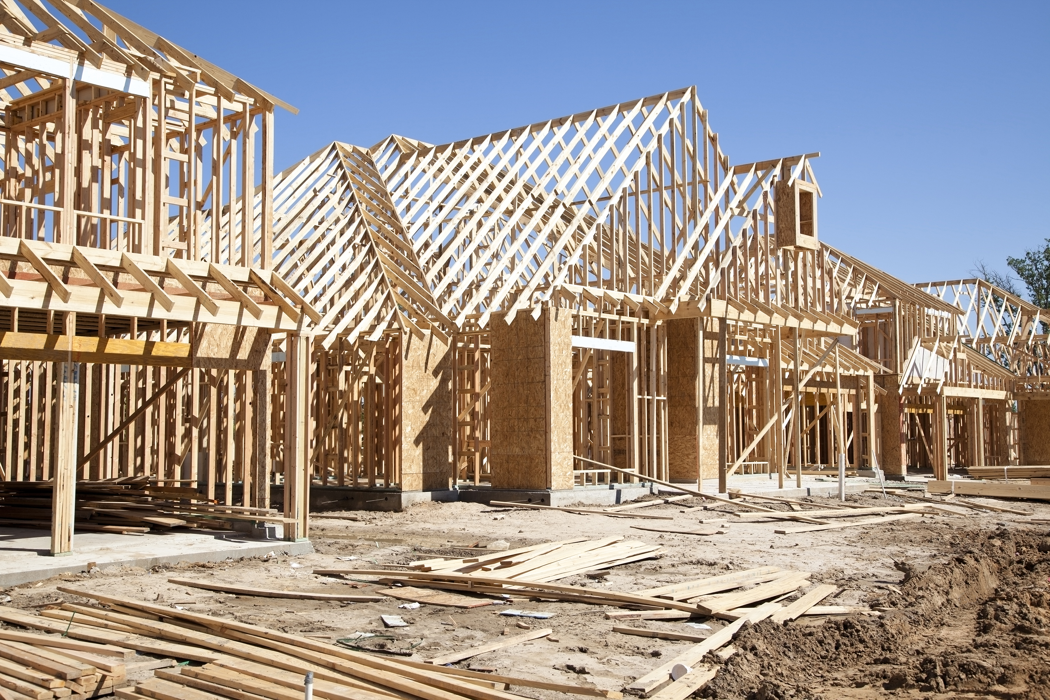
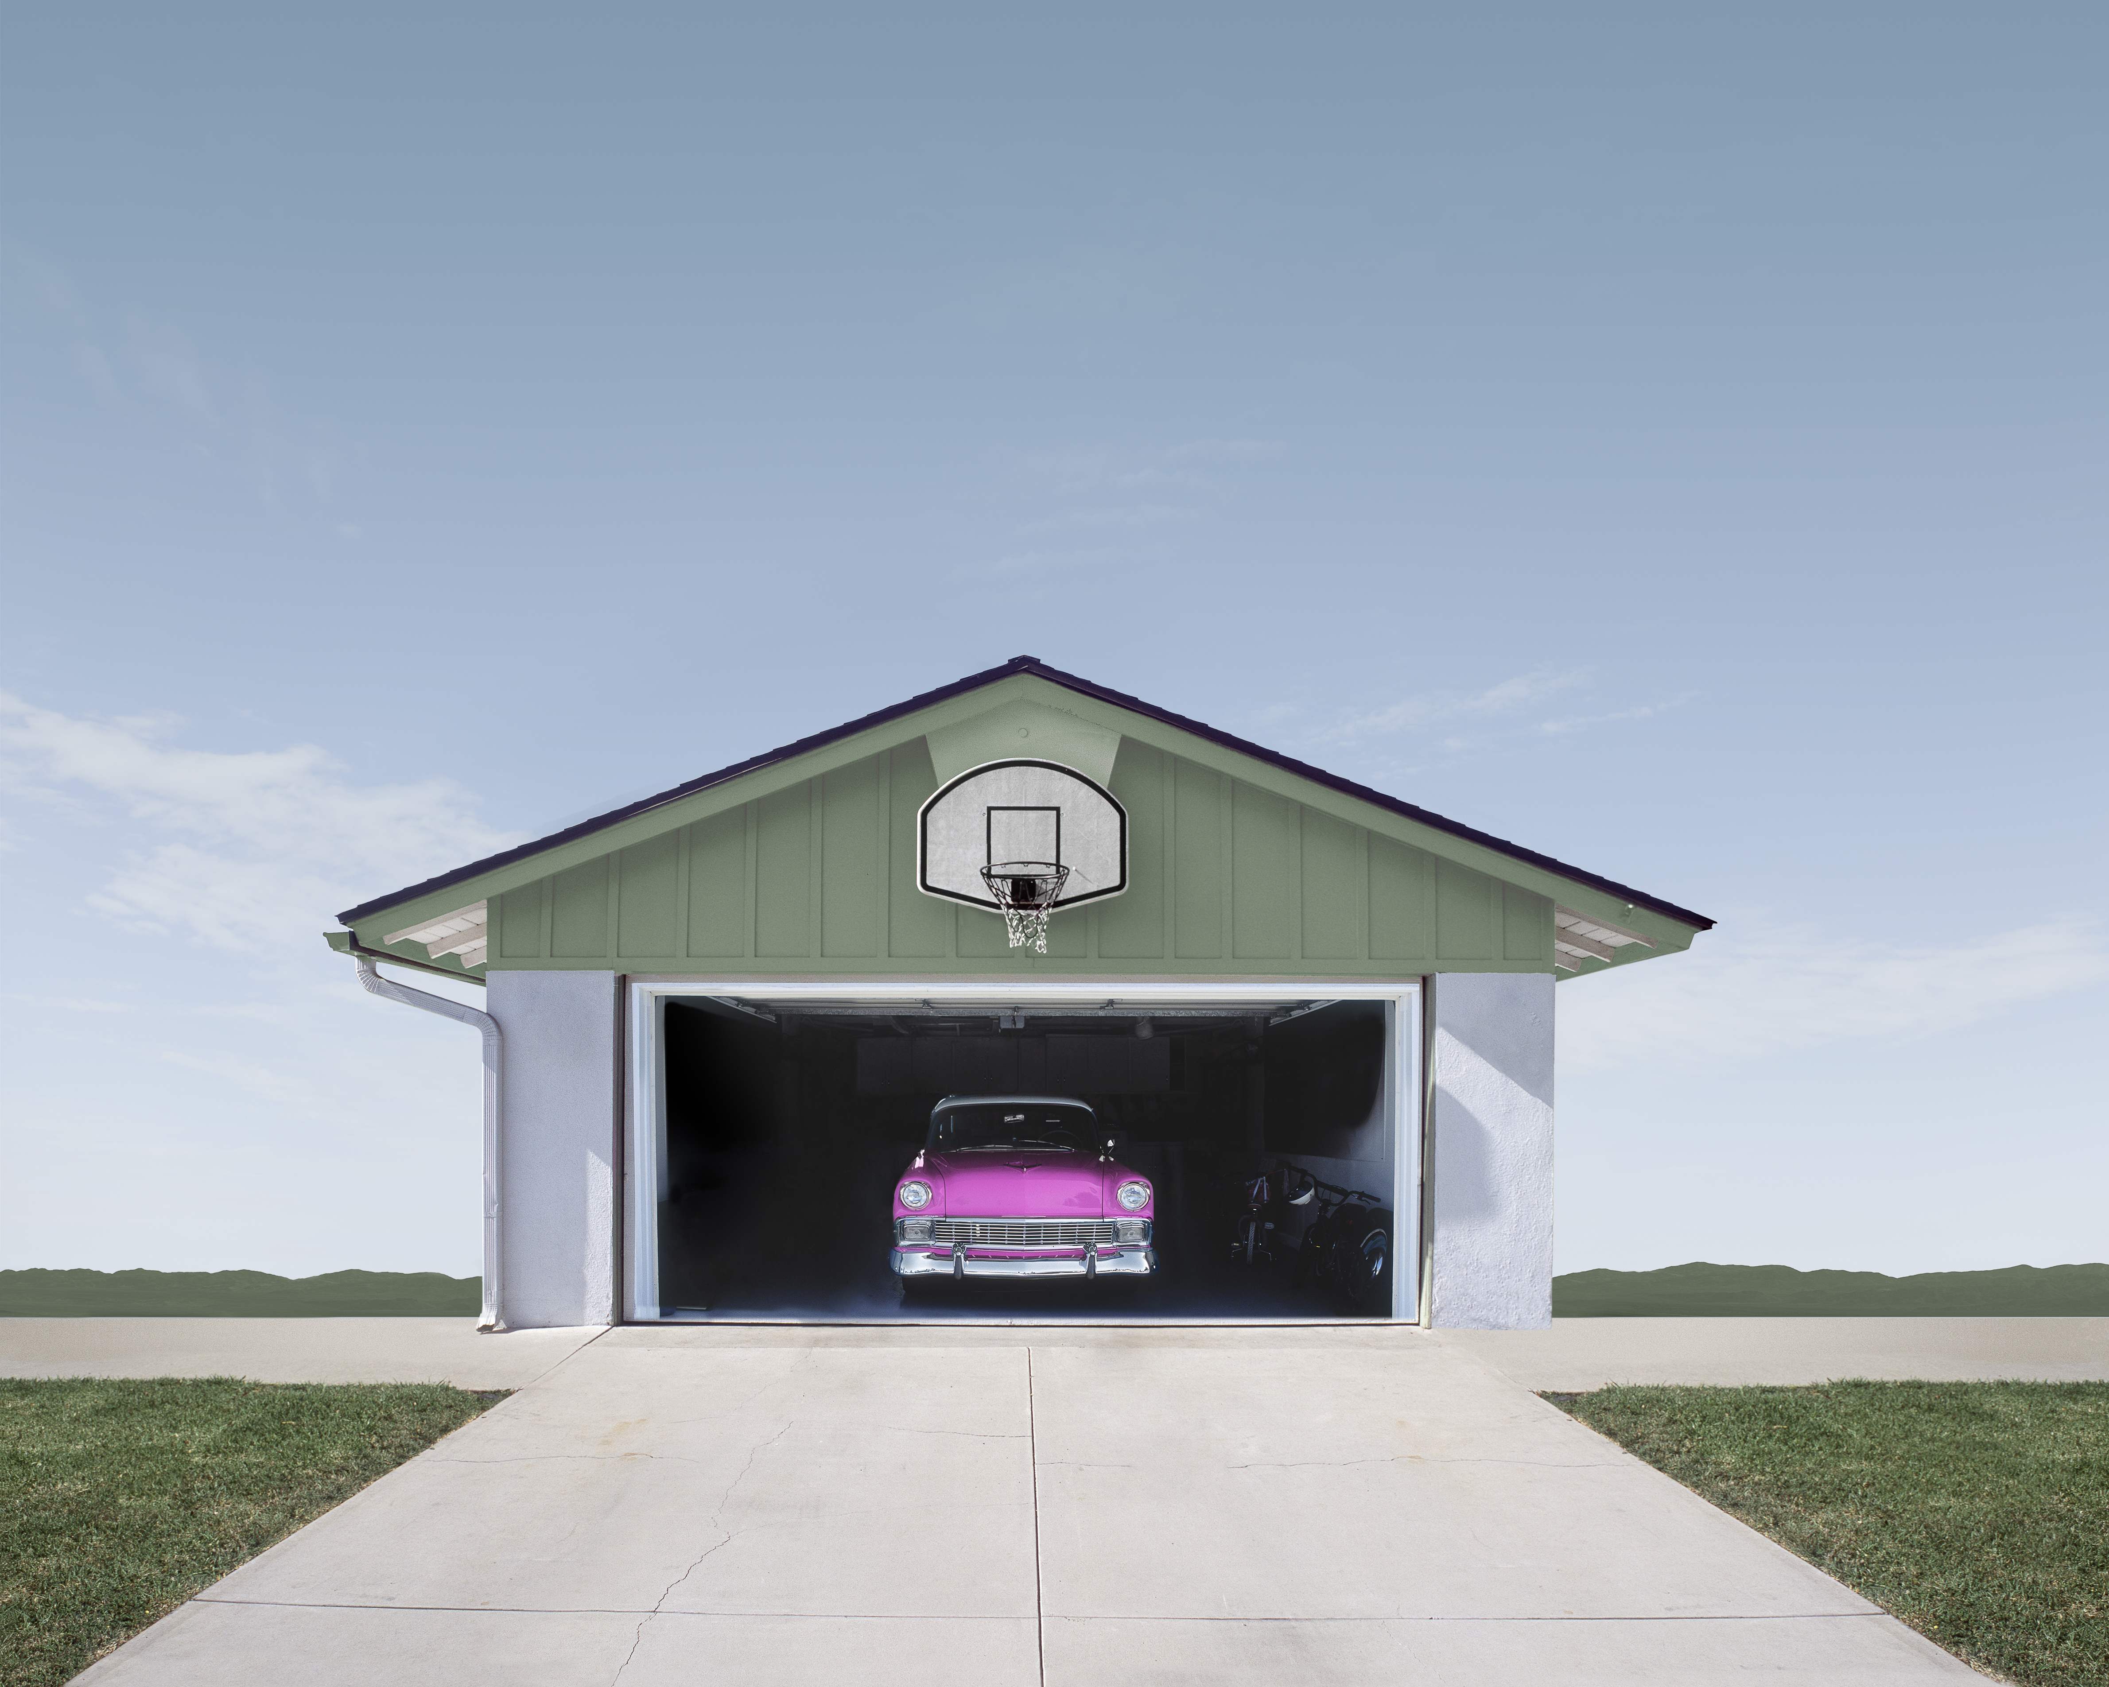

Our Hypotheses
Sales price is not affected by sale condition
Garage type does not affect sale condition
More bedrooms result in a higher sale price

Slide 4
Sales price is affected by sale condition

Slide 5
Sales price is affected by sale condition
t-Test: Two-Sample Assuming Unequal Variances
 | Not Built In | Built In
Mean | 176185.7092 | 254751.7386
Variance | 5680679144 | 10451147590
Observations | 1372 | 88
Hypothesized Mean Difference | 0
df | 93
t Stat | -7.086841502
P(T<=t) one-tail | 1.3025E-10
t Critical one-tail | 1.661403674
P(T<=t) two-tail | 2.605E-10
t Critical two-tail | 1.985801814
total sample size | 1460
mean difference | 78566.02945
standard error of difference | 11086.18408
margin of error | 22014.96446
c.i. lower | 56551.06499
c.i. upper | 100580.9939
Reject the null that there is no difference between the sale price means of Built In and Not Built In garage types.
This difference is significant at < 0.00. With 95% confidence, the difference is between 81184 and 118667

Slide 6
Garage type does affect sale condition

Slide 7
Garage type does affect sale condition
t-Test: Two-Sample Assuming Unequal Variances
 | Not Built In | Built In
Mean | 176185.7092 | 254751.7386
Variance | 5680679144 | 10451147590
Observations | 1372 | 88
Hypothesized Mean Difference | 0
df | 93
t Stat | -7.086841502
P(T<=t) one-tail | 1.3025E-10
t Critical one-tail | 1.661403674
P(T<=t) two-tail | 2.605E-10
t Critical two-tail | 1.985801814
total sample size | 1460
mean difference | 78566.02945
standard error of difference | 11086.18408
margin of error | 22014.96446
c.i. lower | 56551.06499
c.i. upper | 100580.9939
Reject the null that there is no difference between the sale price means of Built In and Not Built In garage types.
This difference is significant at < 0.00. With 95% confidence, the difference is between 81184 and 118667

Slide 8
More bedrooms DO NOT result in a higher sale price
Correlation = -0.154

Slide 9
Discussion and Recommendations
Based on the t-tests and correlation test I recommend prioritizing:
New Construction Homes (partial)
Homes with Built In Garages
Questions?

